Slide 1

Investors Presentation
March 2017

Slide 2
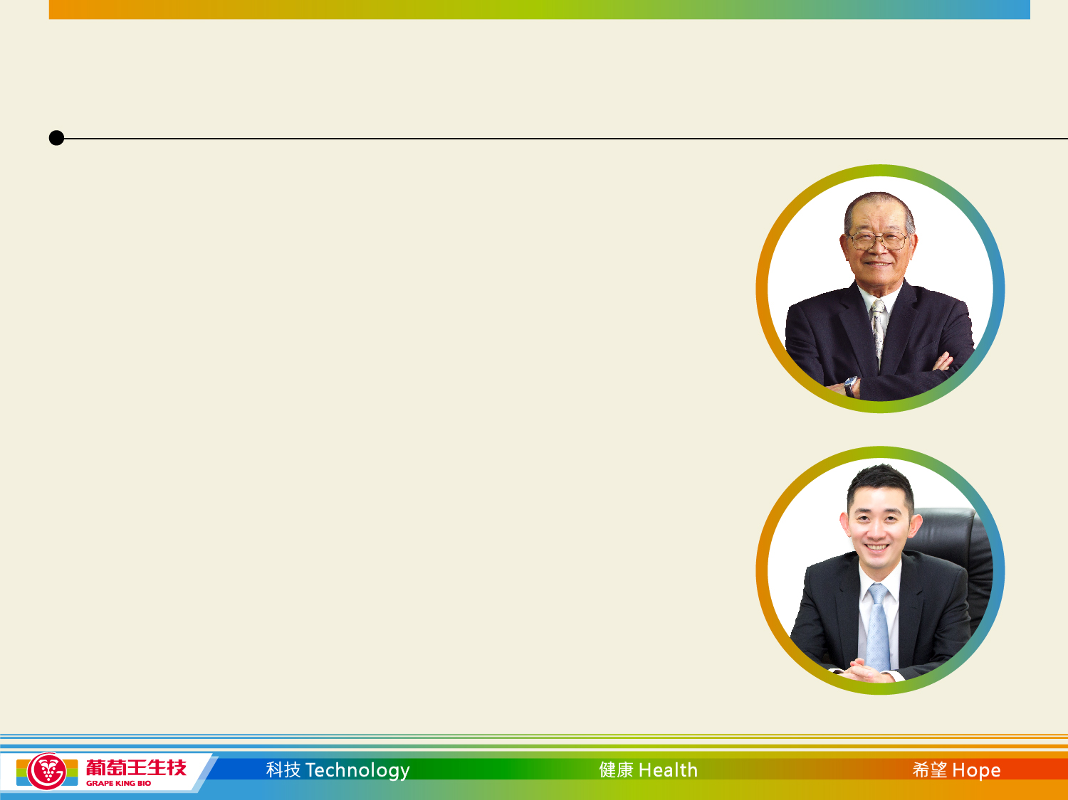
Key Milestones
1969: Grape King started by 3 founders
Founding Chairman, Shui-Chao Tseng
2 Financial Investors
1982: Listed on the TWSE Taiwan exchange
2014: Dr. Sheng Lin Andrew Tseng was
elected CEO & Chairman by the Board
of Directors

Slide 3
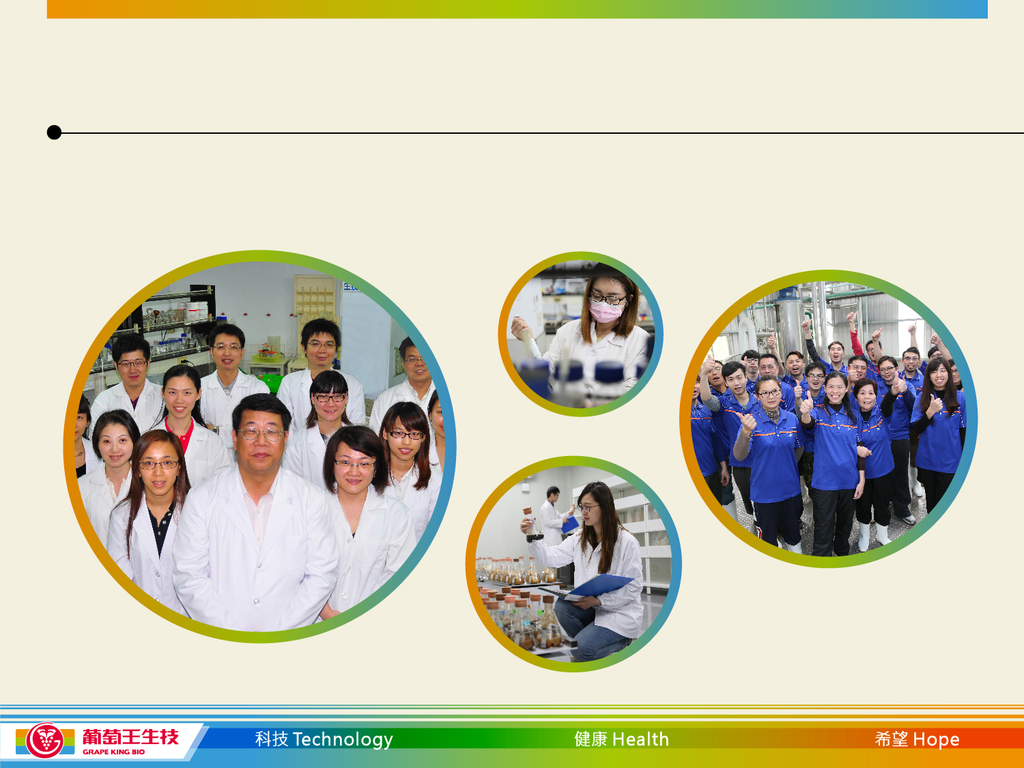
Bio Engineering Centre
1991: Establishment of the Bio Engineering Centre

Slide 4
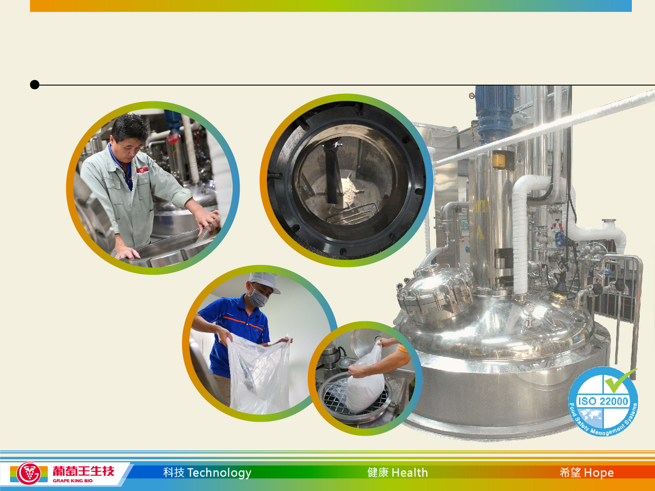
Bio Engineering Centre
Bio Engineering Centre
Taiwan’s
largest
fermentation
facility
281 tons

Slide 5
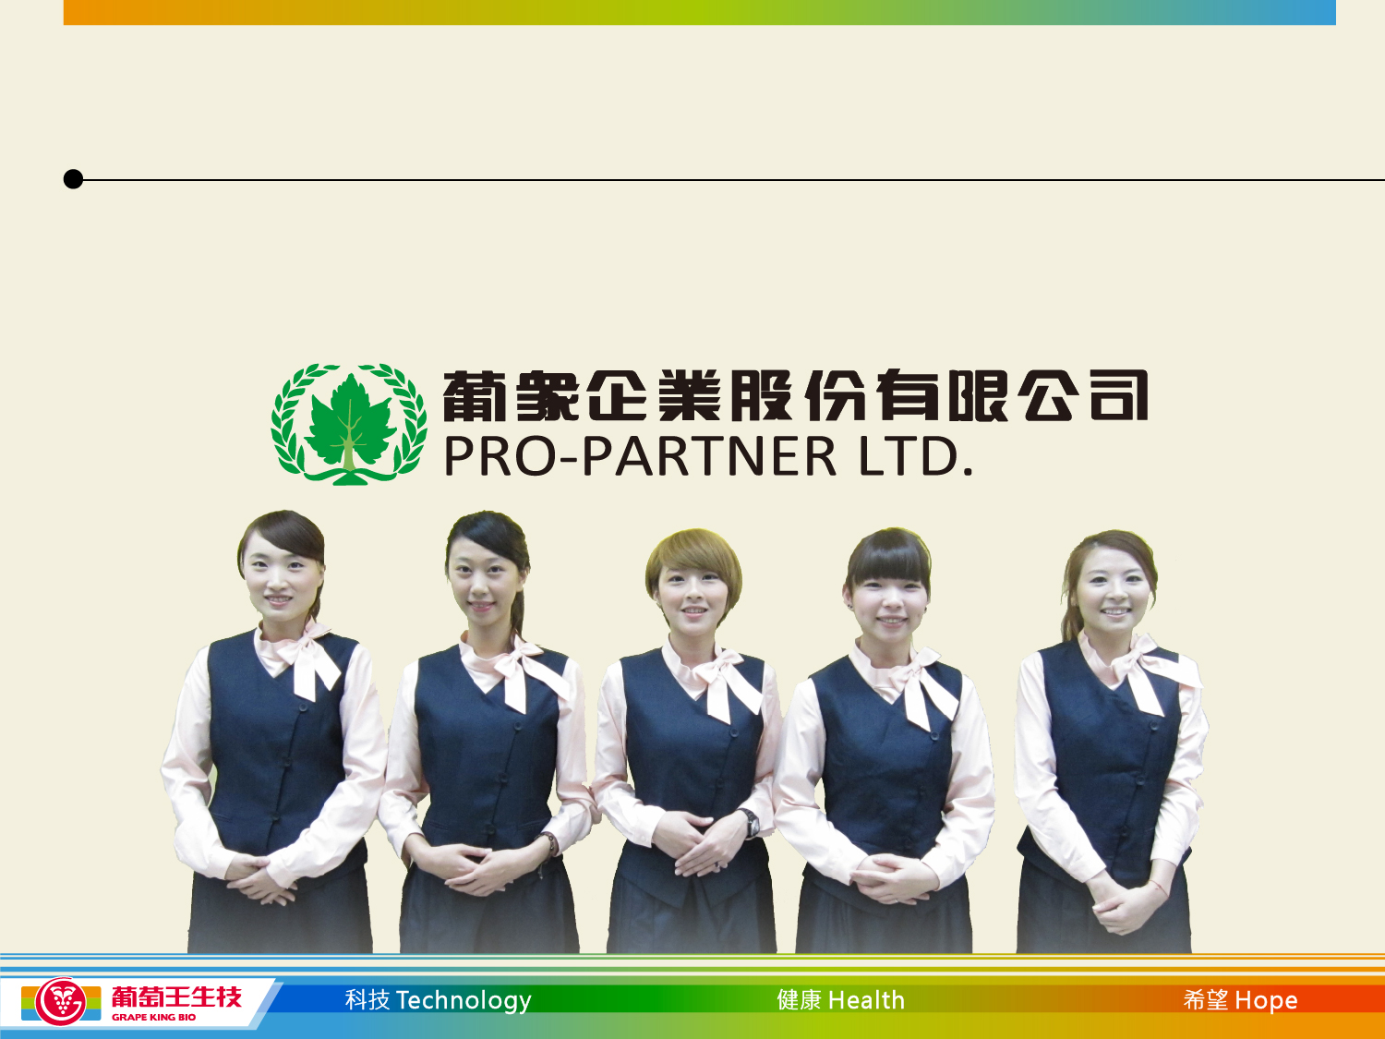
Pro – Partner
1993: Pro-Partner established (multi-level marketing company)

Slide 6
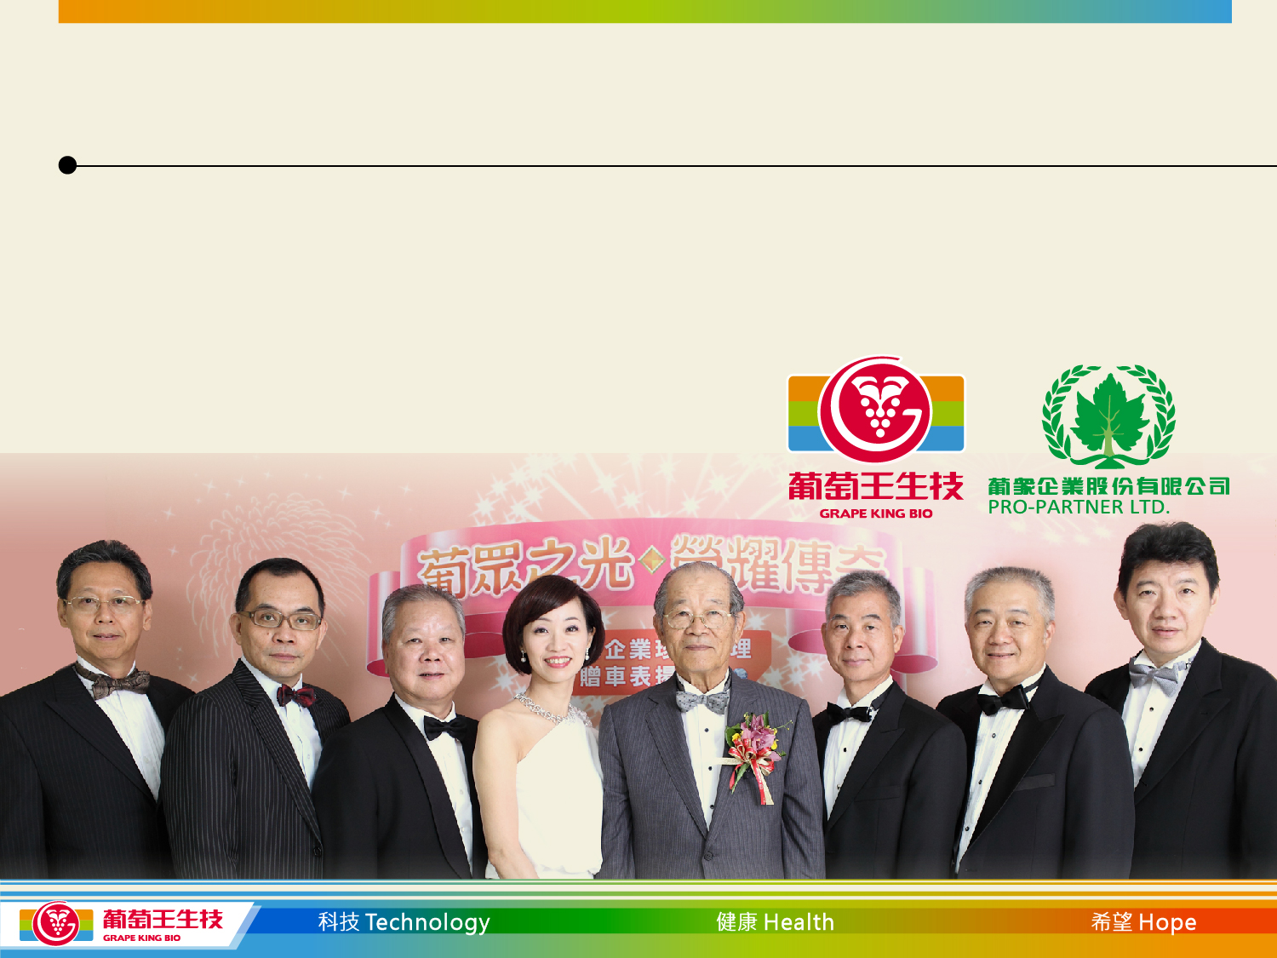
Pro-Partner Shareholders
Pro-Partner was initially 100% owned by GKI
In 1998 a capital injection was done by the new management team - 40% of shares
Grape King Bio owns 60% of shares

Slide 7

Pro-Partner Achievements
1
Largest Taiwanese owned MLM company
2
Since 2014 ranked No.2 on the list of MLM companies in Taiwan (based on turnover)
5
Youngest company amongst the top 5
24
Has the smallest product range – 24 Health and Beauty products
66
No. 66 in the worldwide MLM rankings for 2013
190,000
Currently has more than 190,000 members

Slide 8
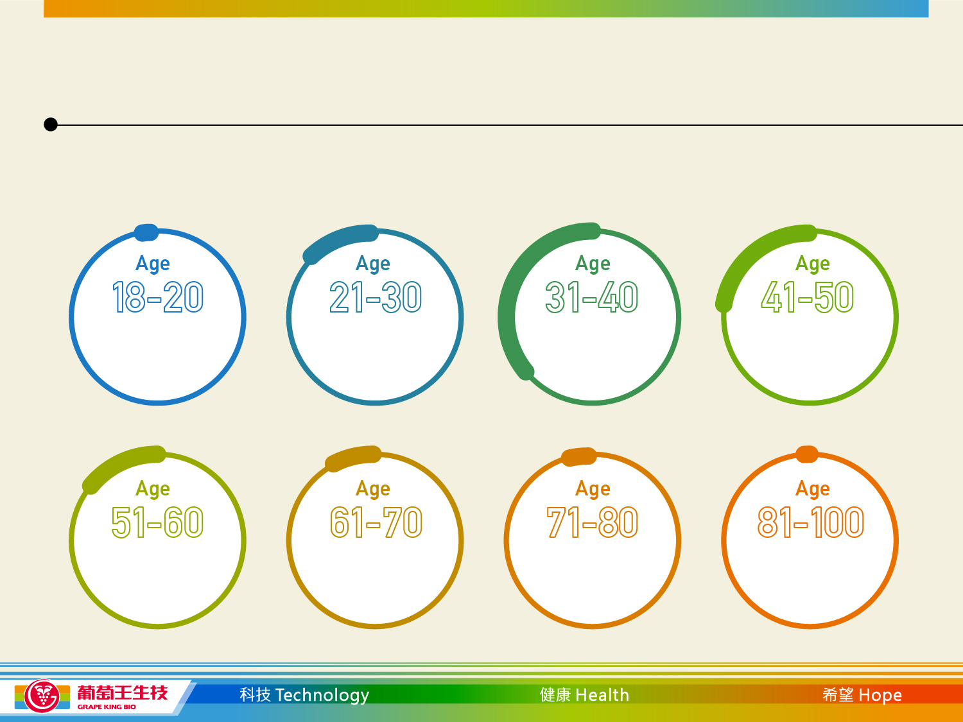
Pro-Partner Members Profile
February 2017, Pro-Partner has 194,006 active members
1.18%
14.24%
35.36%
23.46%
15.30%
8.19%
1.91%
0.35%

Slide 9
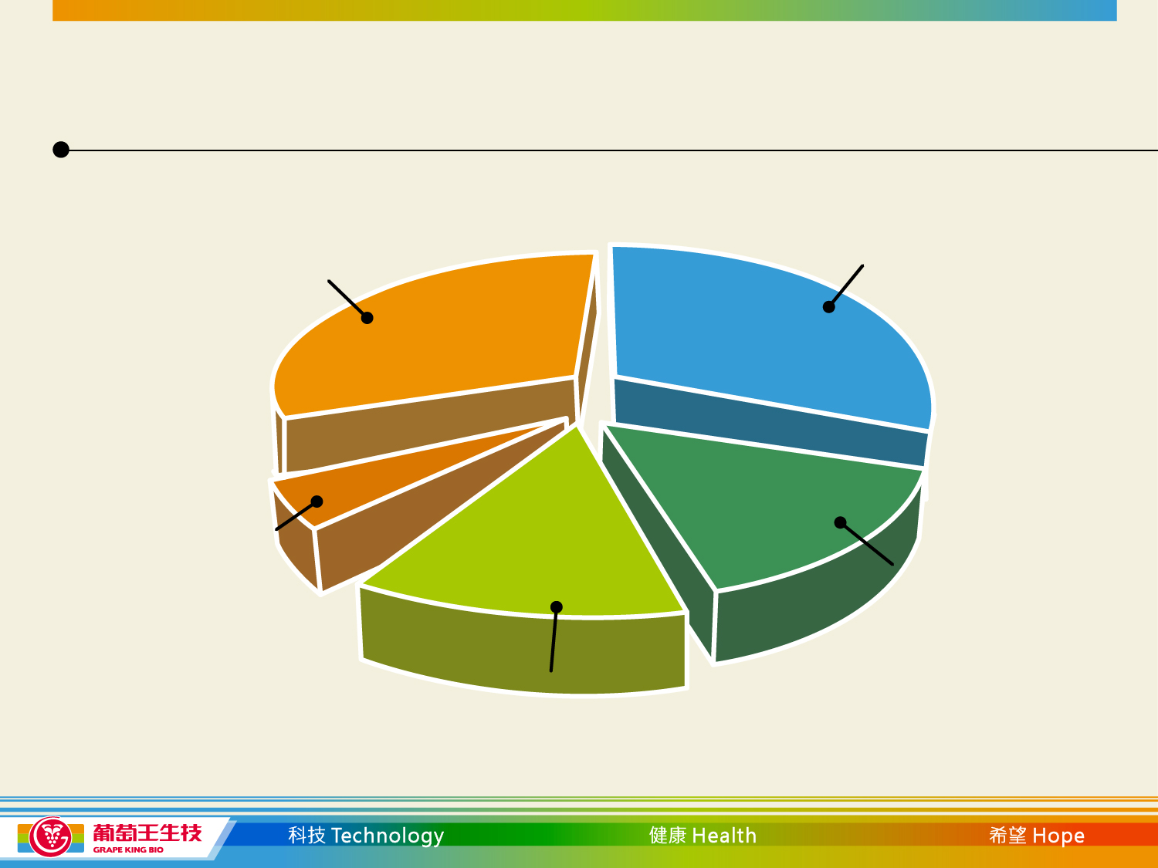
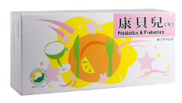
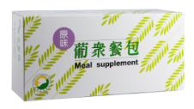
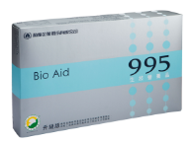
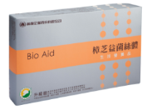
2016 - Pro-Partner Top 4 Products
5.Other
35.79%
1. Probiotics & Prebiotics
32.16%
4. Meal Supplement
(Original)
5.4%
2. 995 Nutrition Aqua
14.84%
3. Antrodia Aqua
11.81%

Slide 10
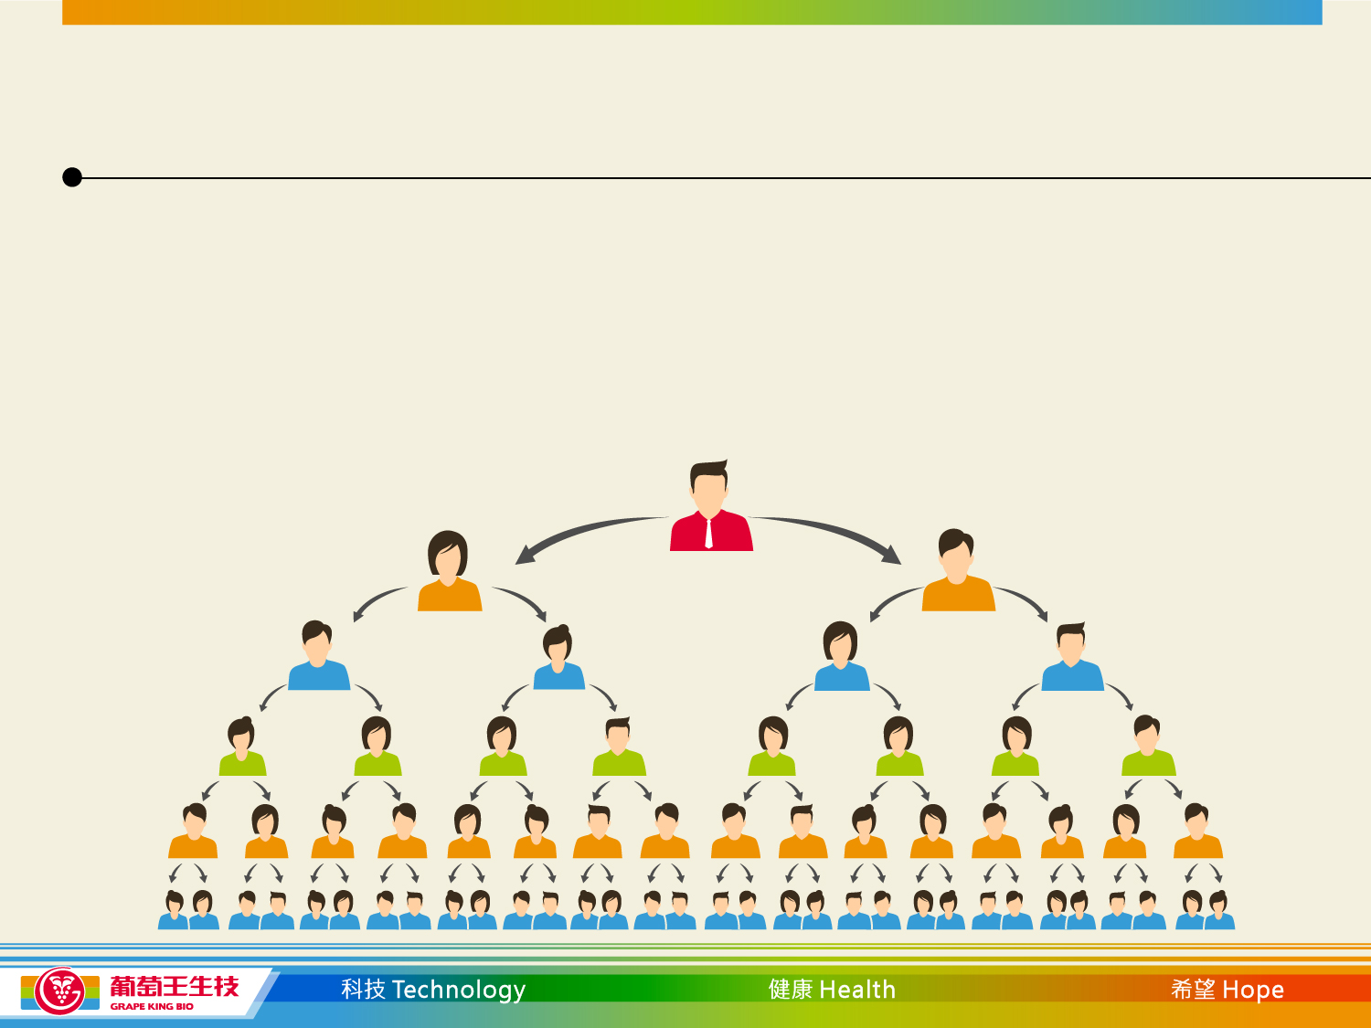
Pro-Partners Incentive and Bonus System
NT$1,000 to become a member
Incentives and bonuses depend on what the member status
is and how many people they have below them

Slide 11
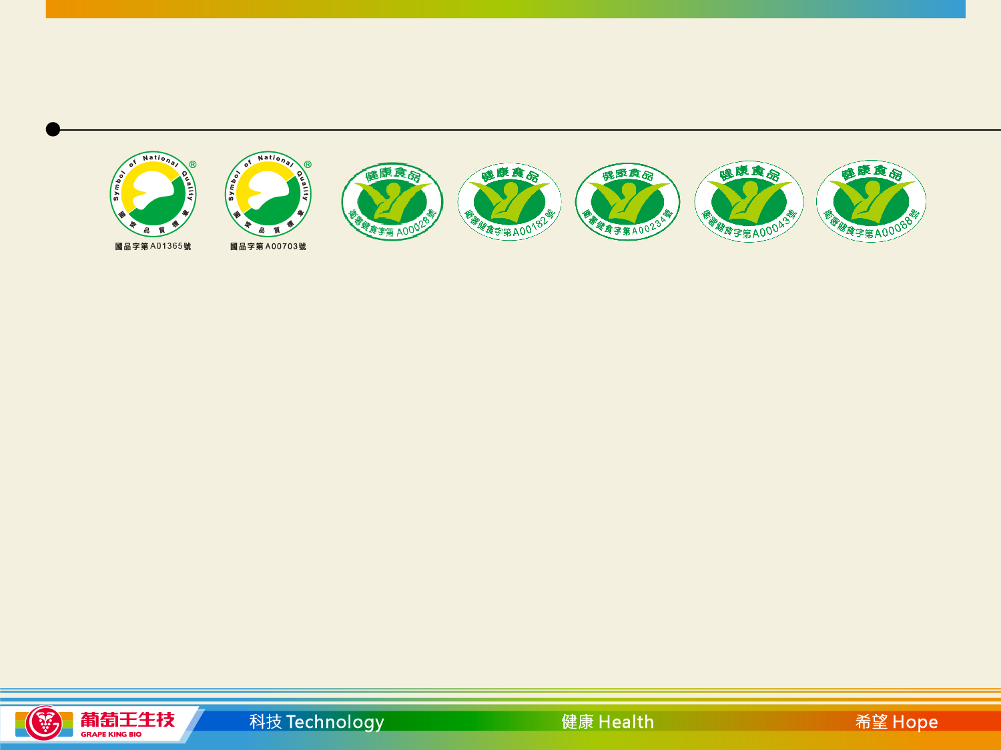
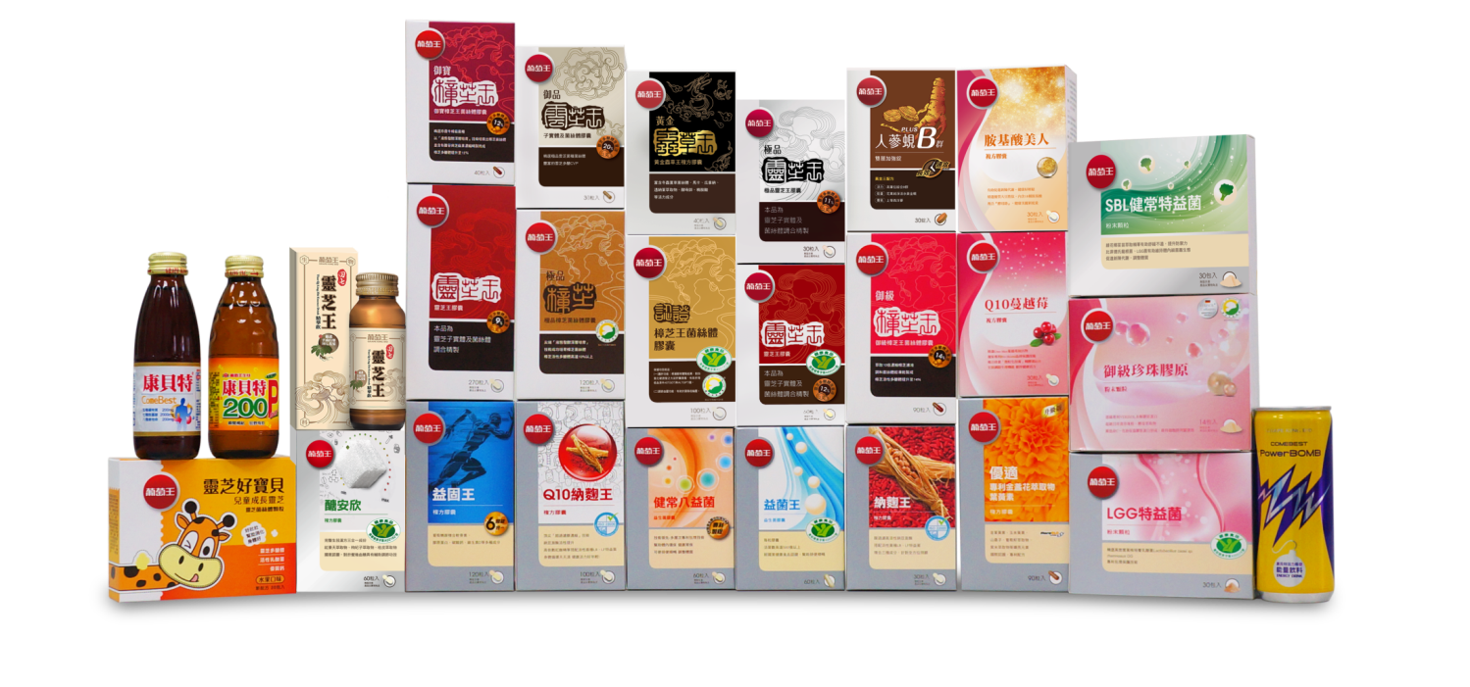
Grape King Products

Slide 12
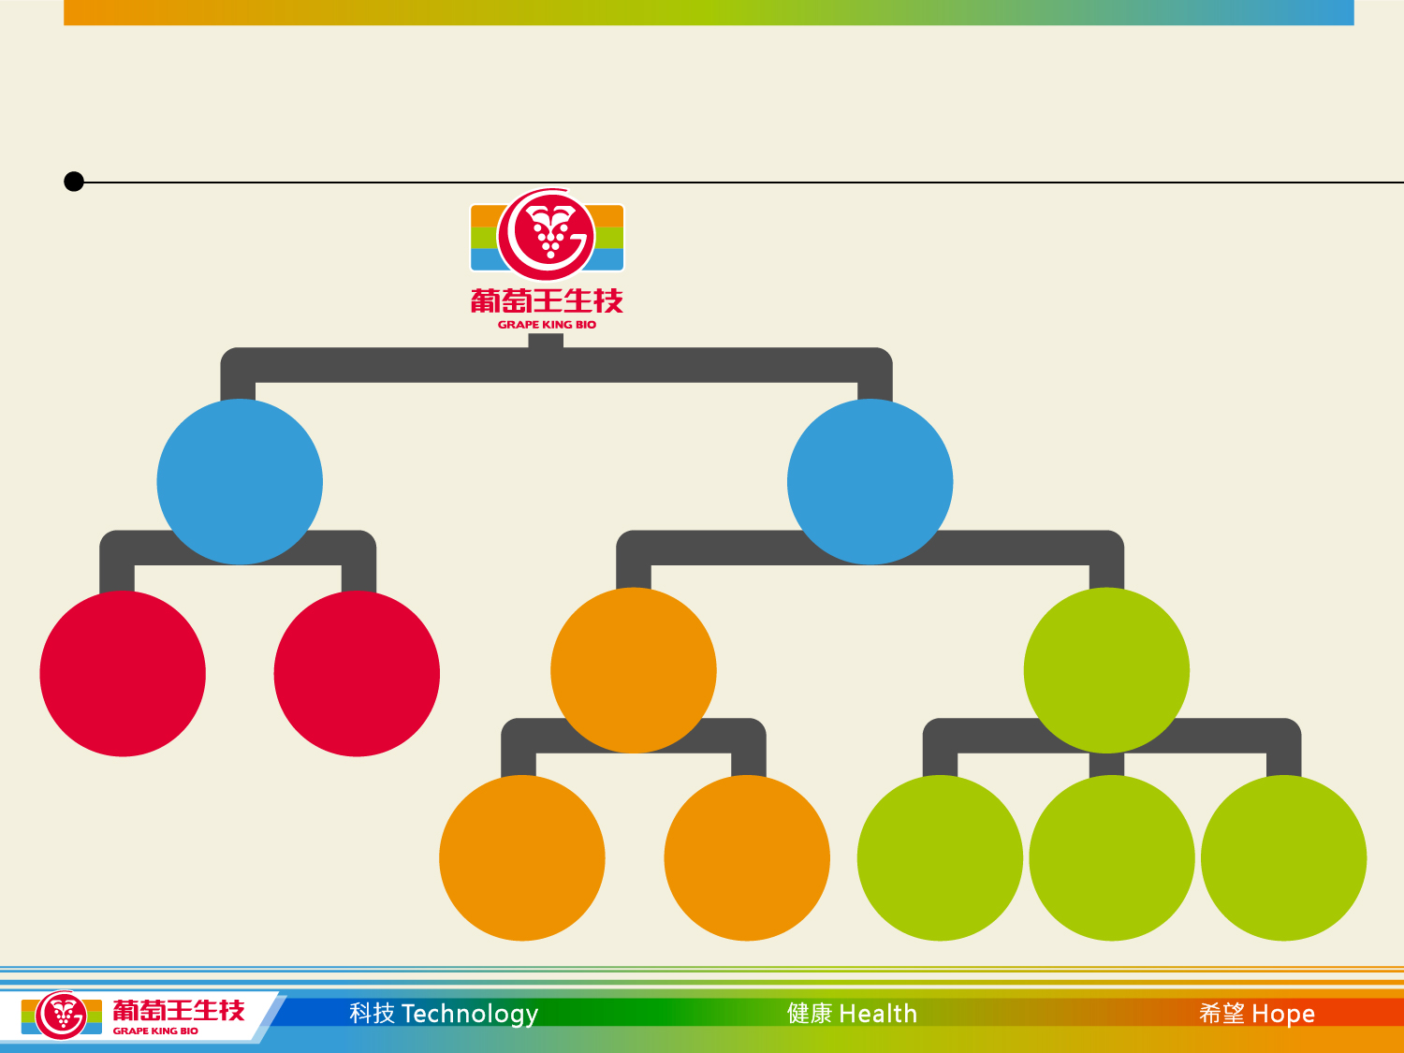
Grape King Brand Sales Channels
Beverage
Bio Products
Physical
Channels
Virtual
Channels
Retail
Distribution
Modern Retail,
Costco,
Cosmed,
Watsons,
Post Office, etc.
Online and
Catalogue
shopping
Traditional
Pharmacy
TV Shopping
Channel
Grape King
e-Shop

Slide 13
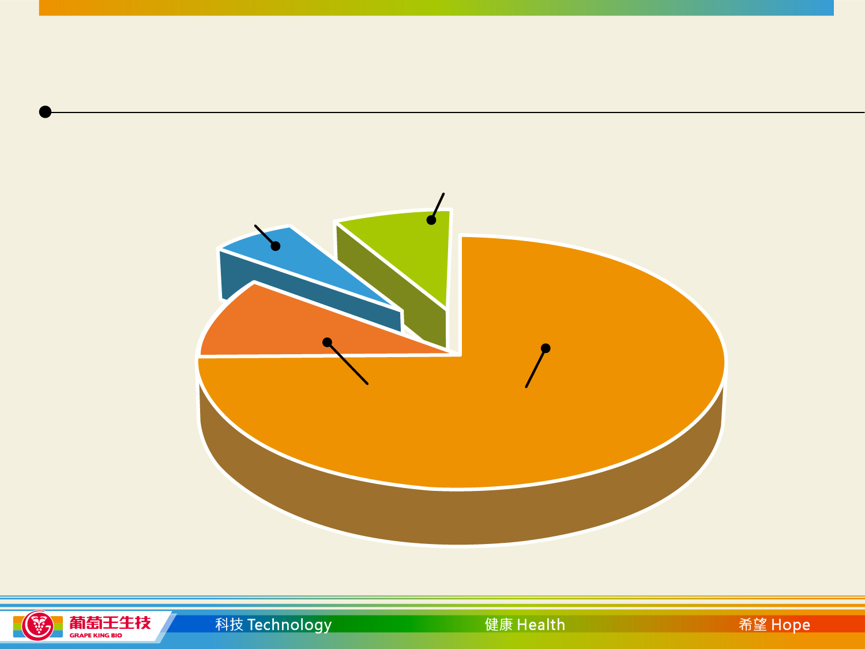
G.K. Bio (Stand alone) Jan 2017 Sales
Other 5%
(OEM/ODM)
Energy drinks 5%
Branded health food products 90%
(Grape King brand 7 % + Pro-Partner brand 83%)

Slide 14
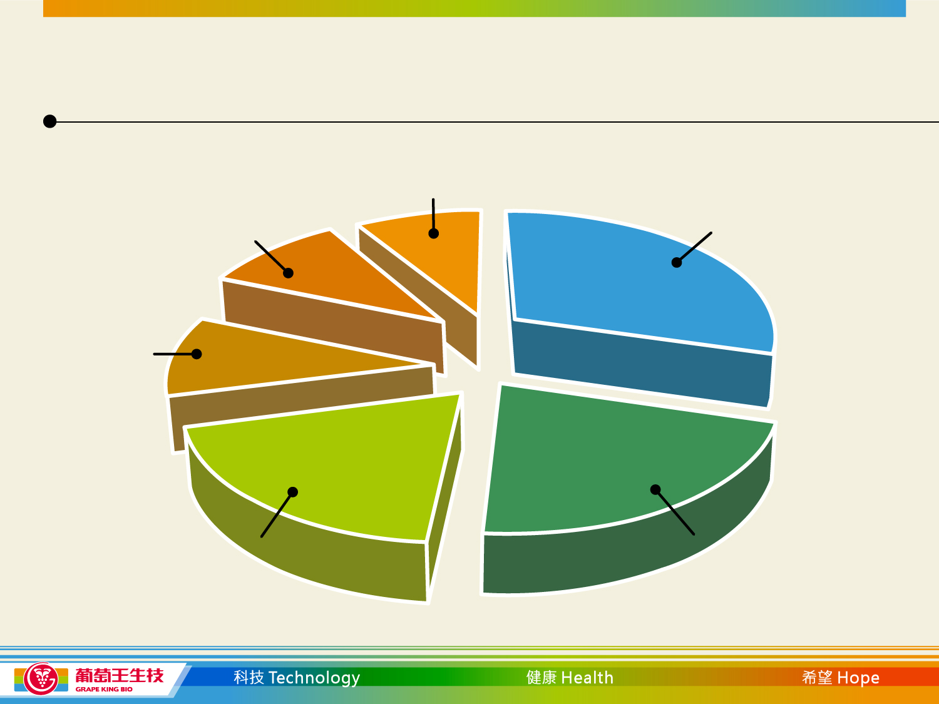


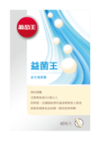
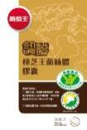

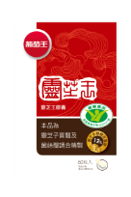
2017 Jan Grape King Product Sales
6. 200P 9.29%
5. Probiotics
11.29%
1. Combest
24.66%
4. Antrodia
13.44%
2. PowerBOMB
21.73%
3. Ganoderma
17.03%

Slide 15
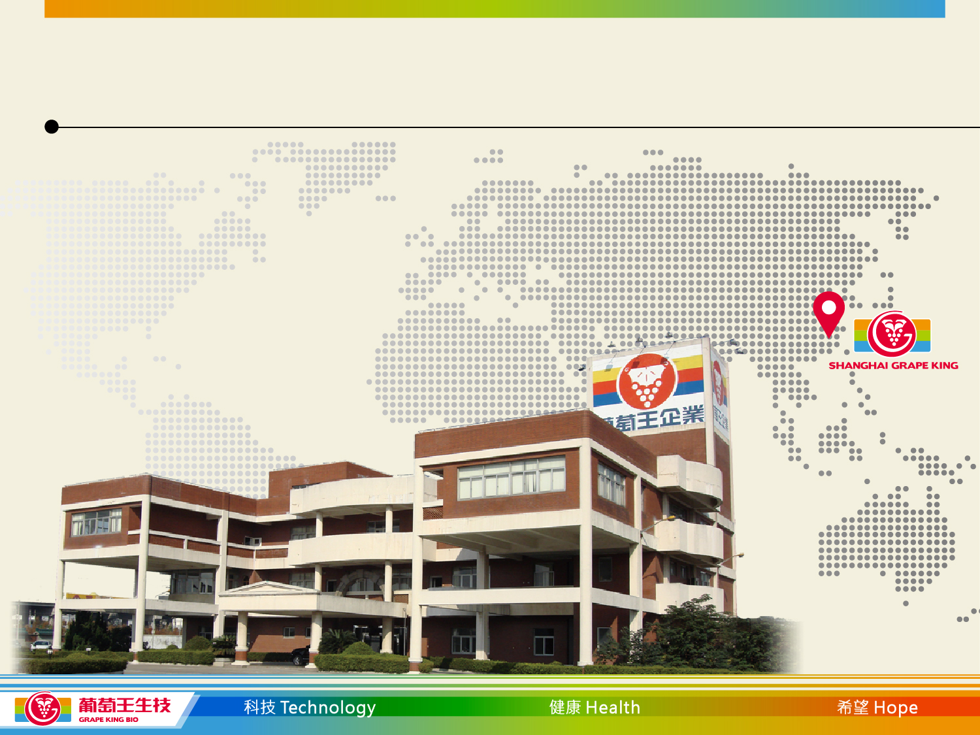
Grape King Shanghai
1994 - Grape King plant established in Shanghai - 100%
owned by Grape King Bio
1997 - 116,400 sq.m piece of land was acquired

Slide 16
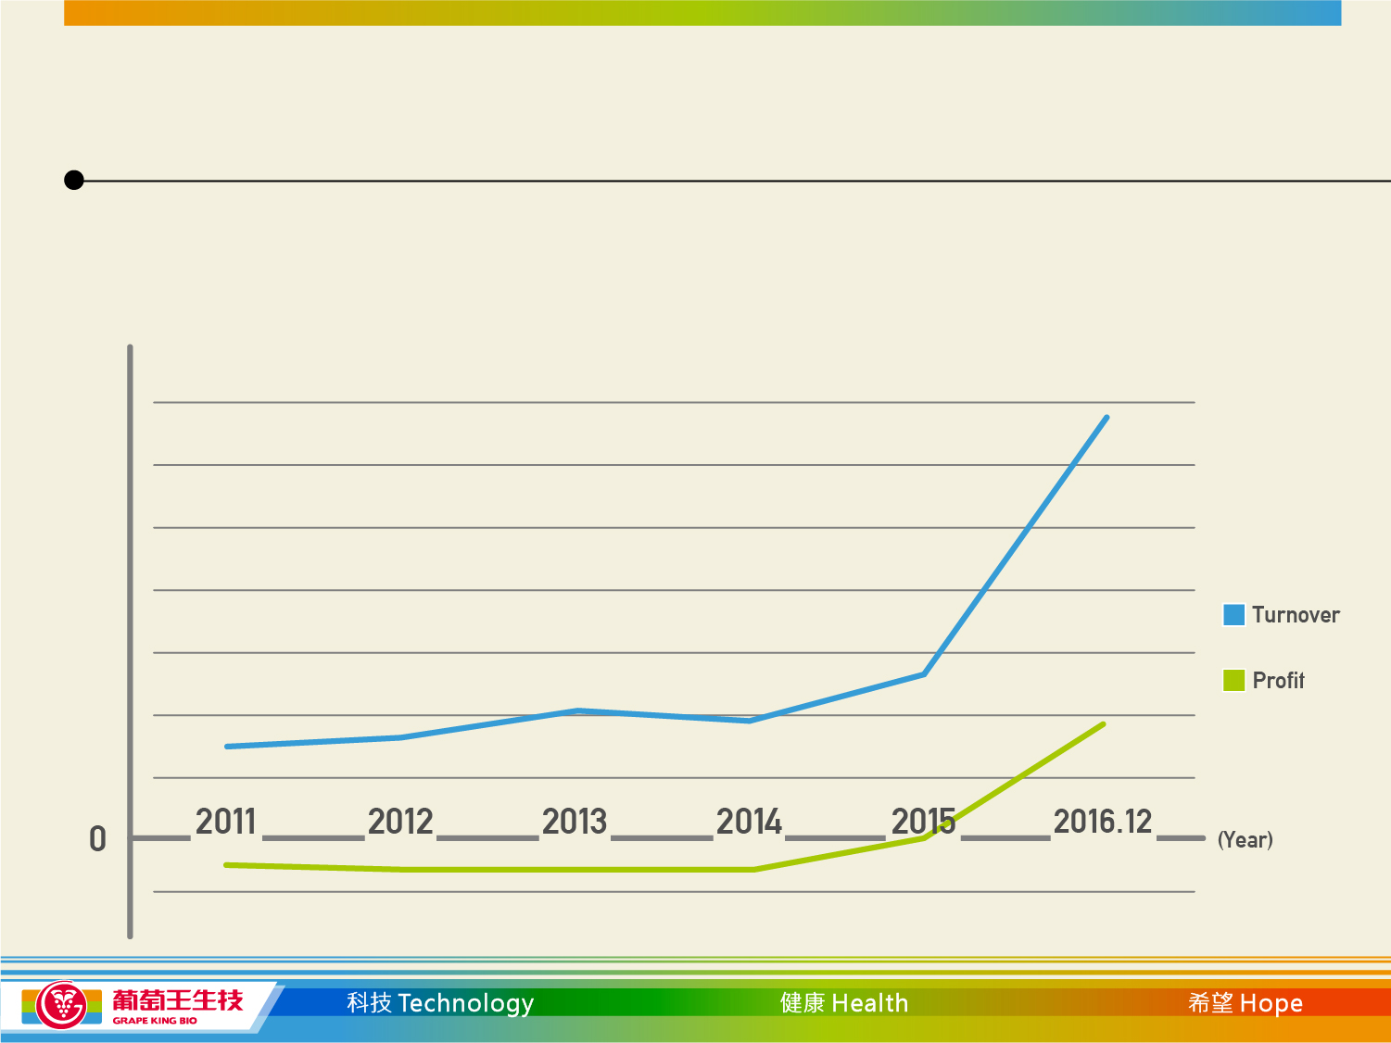
Grape King Shanghai Performance
2015- Grape King Shanghai achieves 72% revenue growth and reaches profit level for the first time in the company’s history
2016 YOY revenue grew 272%.
NT$ 597 million

Slide 17
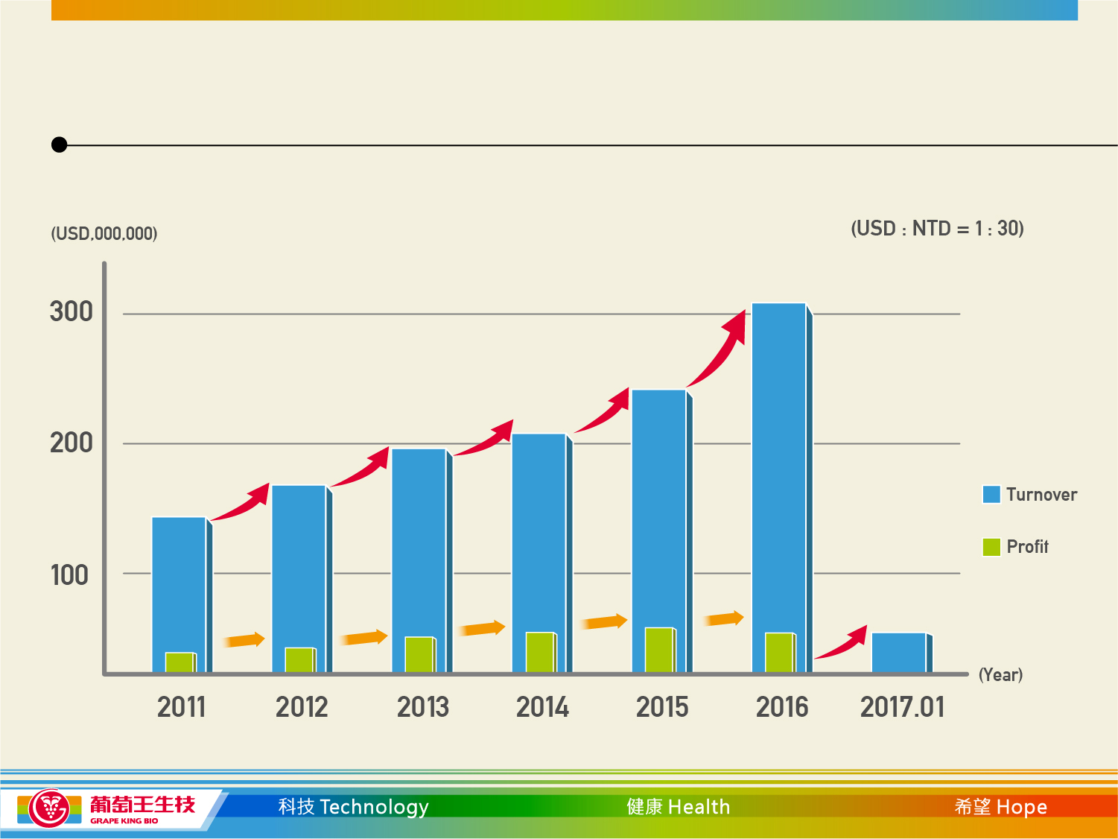
Grape King’s Consolidated Figures
26.75%
$306
15.08%
$242
11.39%
$201
22.61%
$194.98
22%
$159
$131.8
35%
13%
12%
23%
$23.2
31%
$27.8
$31.4
$35.5
10%
$ 15.8
$20.6
$30.4*
*Up to Q3

Slide 18
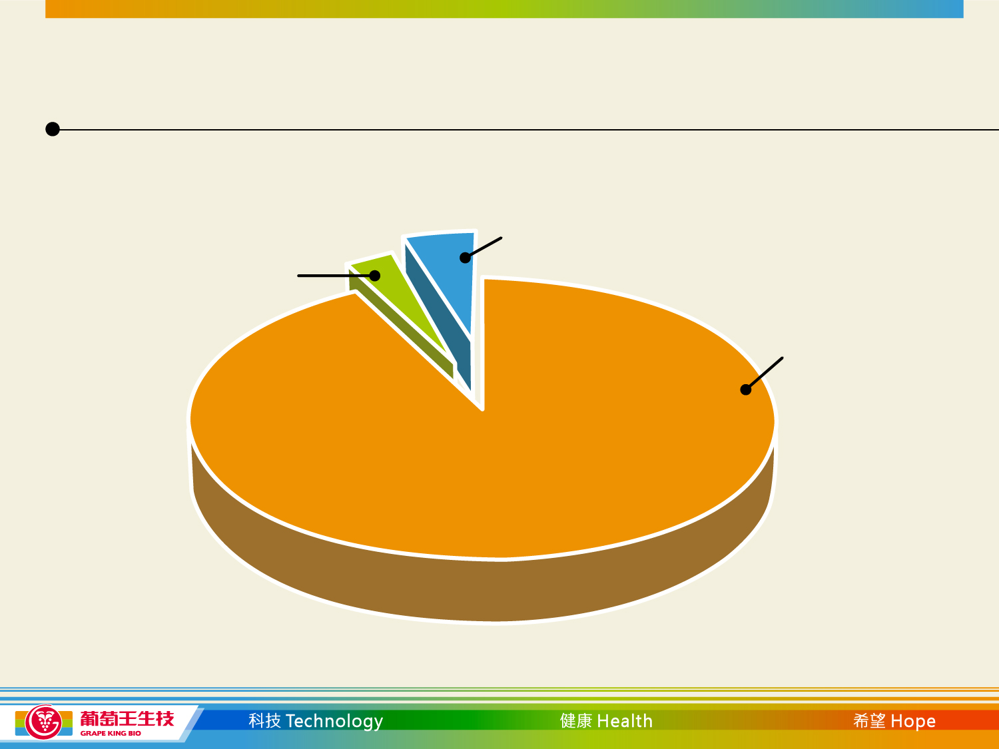
2016 - Consolidated Turnover
Grape King Shanghai
6.5%
Grape King Bio
4.6%
Pro-Partner
88.9%

Slide 19
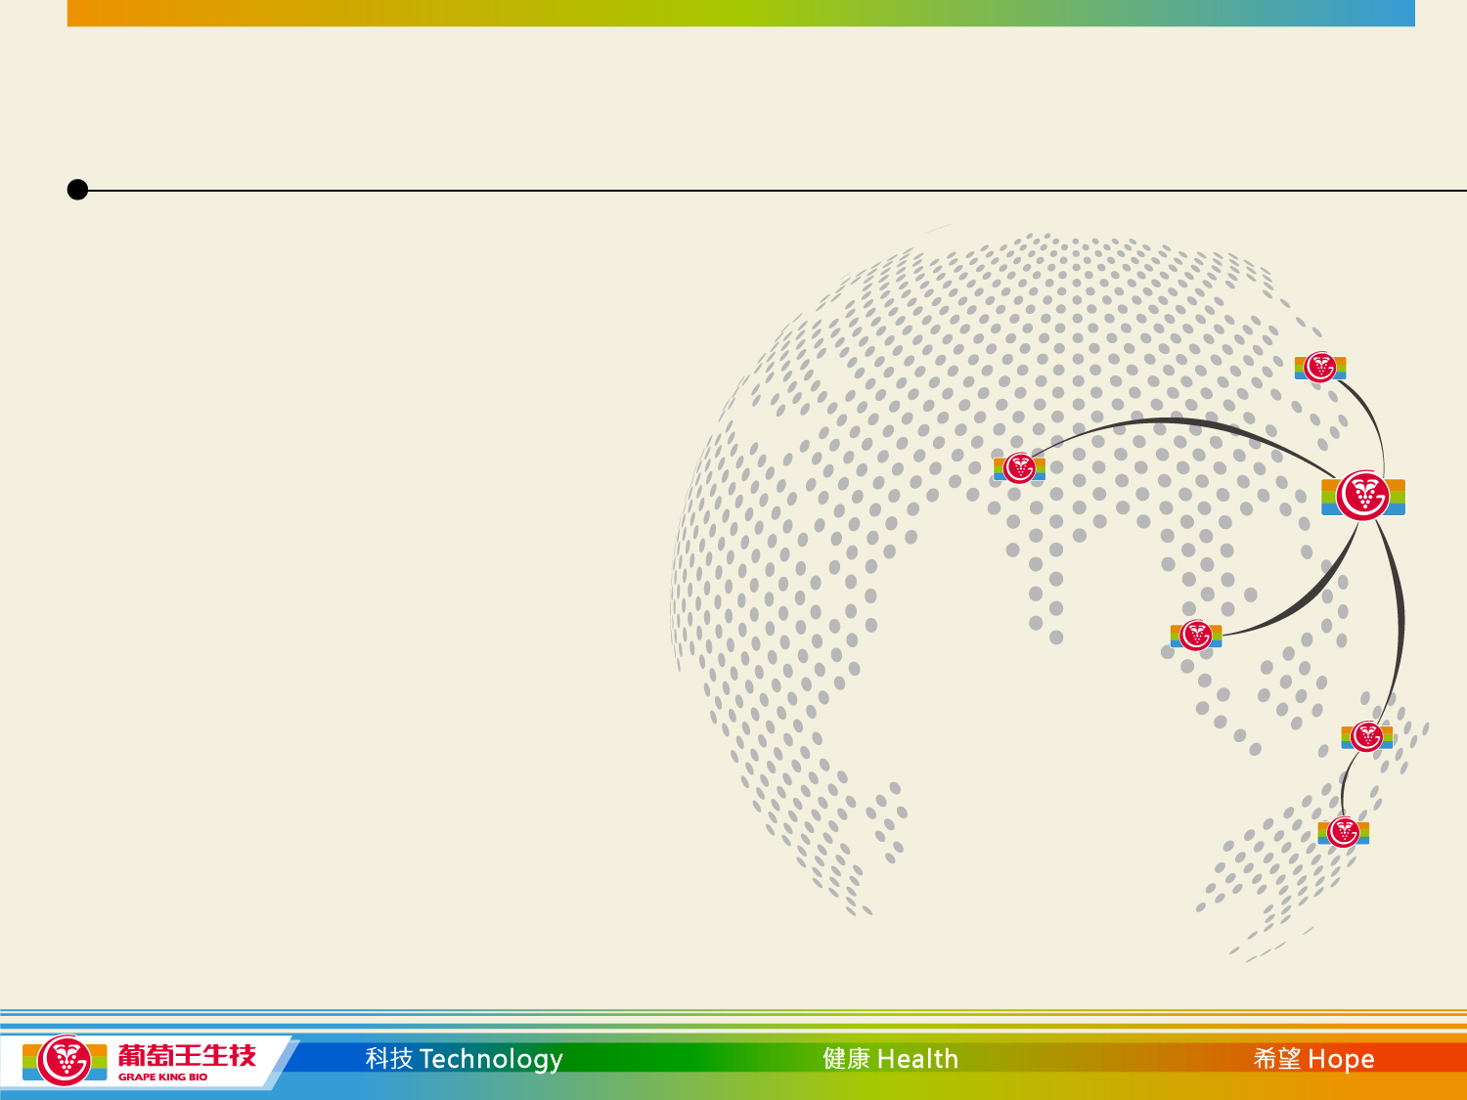
Overseas Business Development
Work with trusted, well established Partners in South
East Asia who have a good reputation within the health
food industry in their own market
We have already started to apply for product
certification in Malaysia, Indonesia, Thailand, Singapore
and Hong Kong

Slide 20
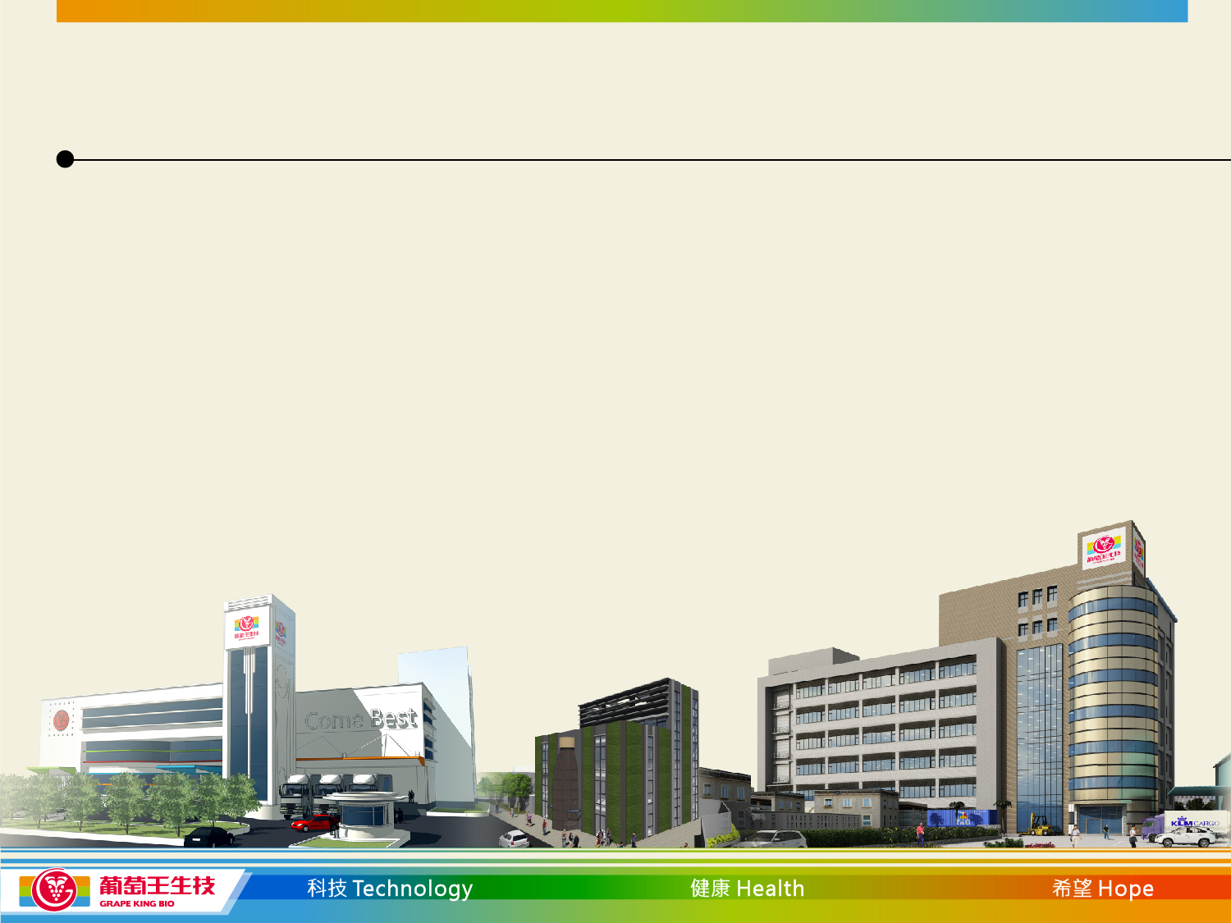
Current Expansion Project
Construction of the second fermentation facility at Long Tan
Science Park has now started.
The facility will increase fermentation capacity by 300 tons.
Estimated date of completion will be mid 2018.
Capex for this project is NT$ 1 billion
(Spread over construction and ramp up period).

Slide 21

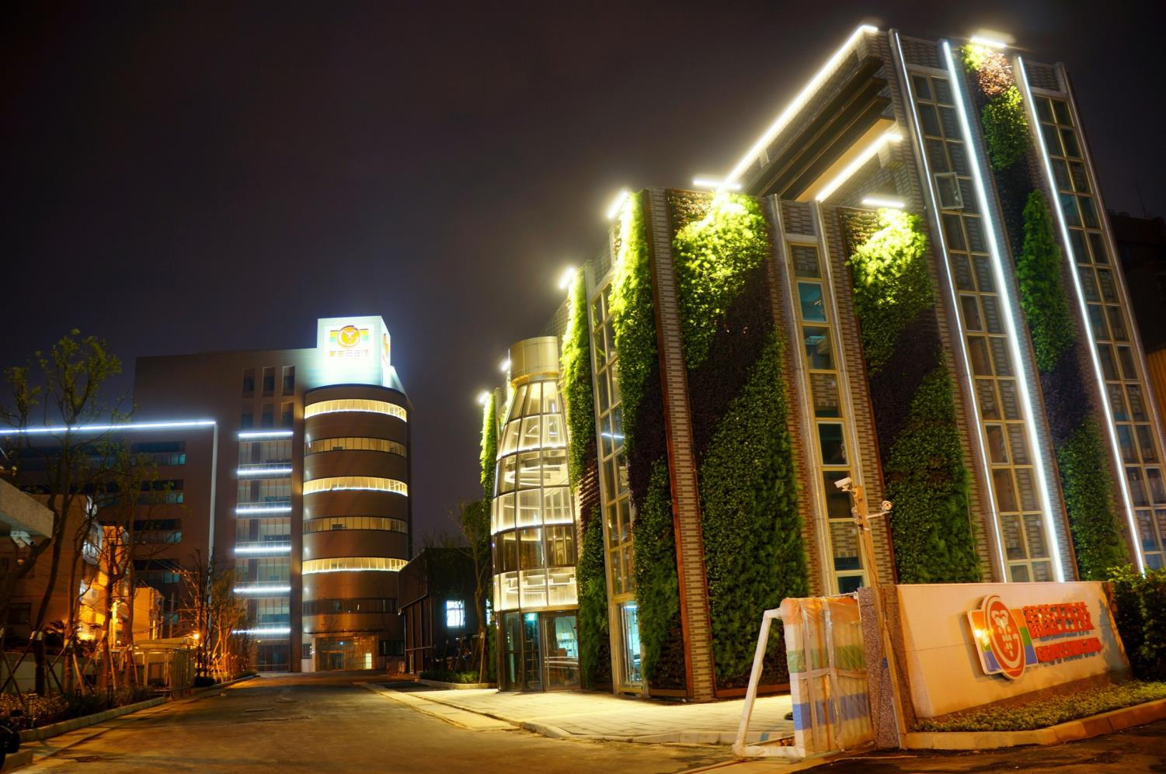

Slide 22
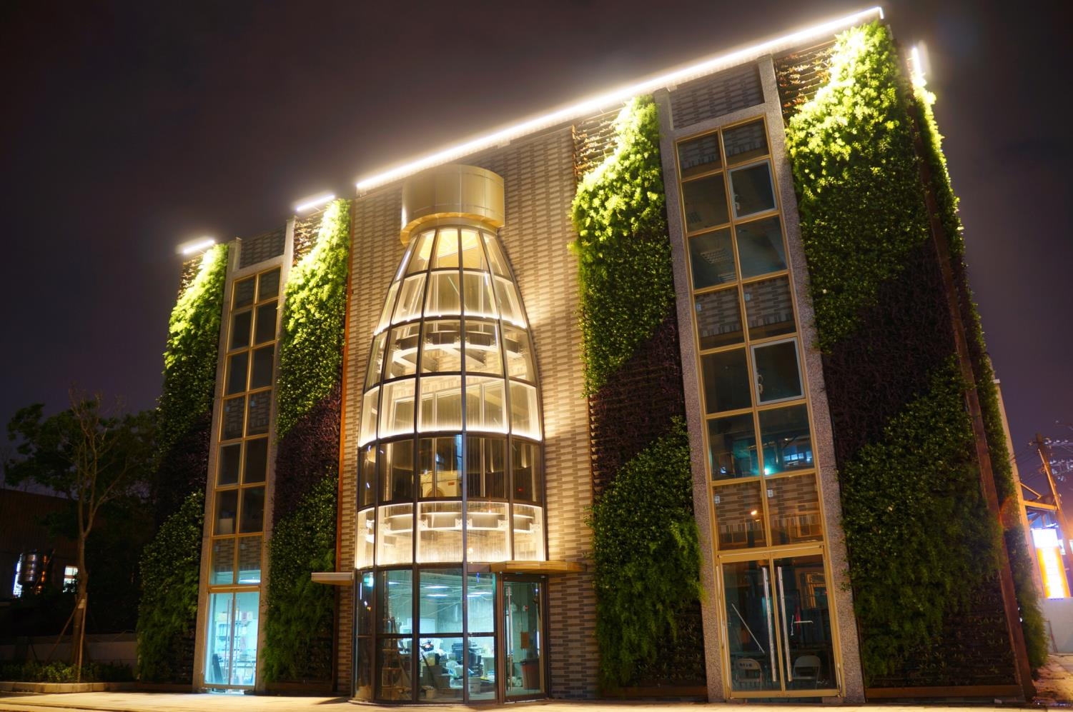

Slide 23
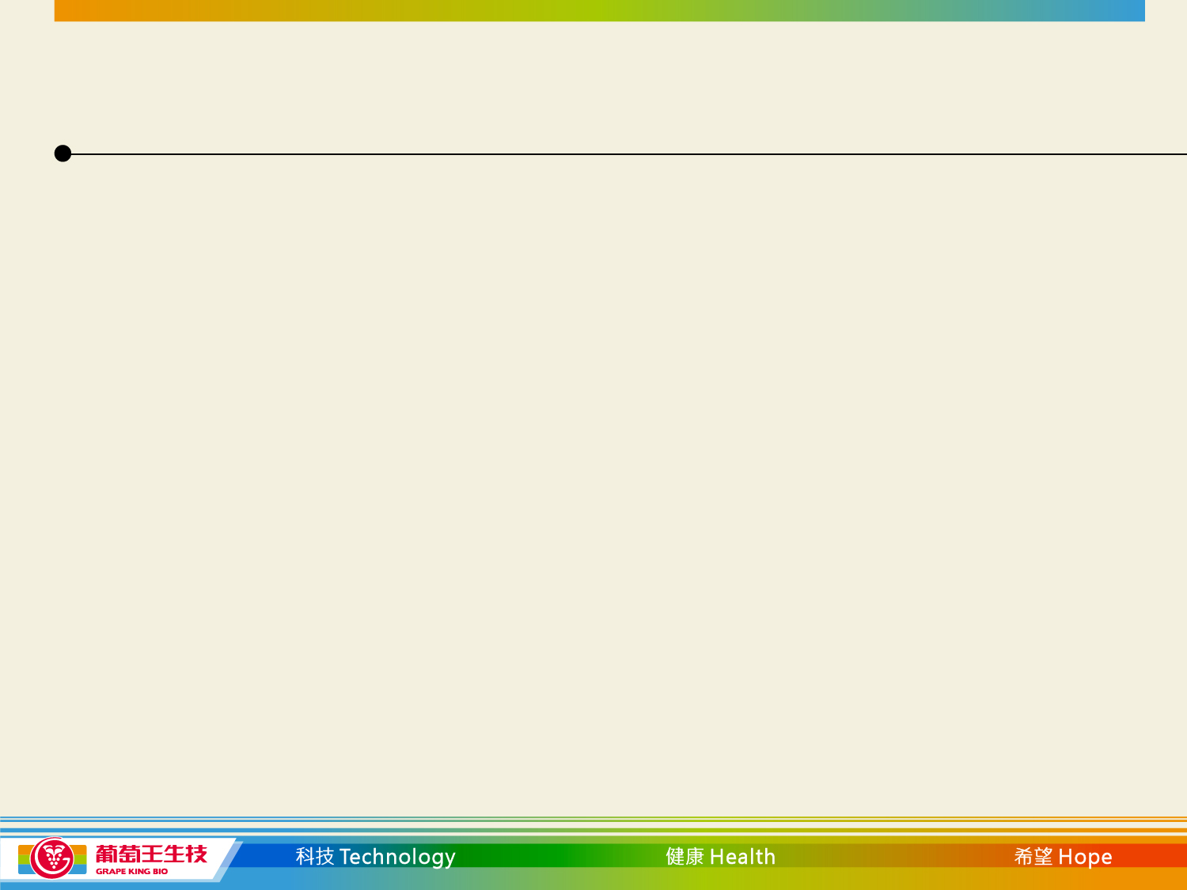
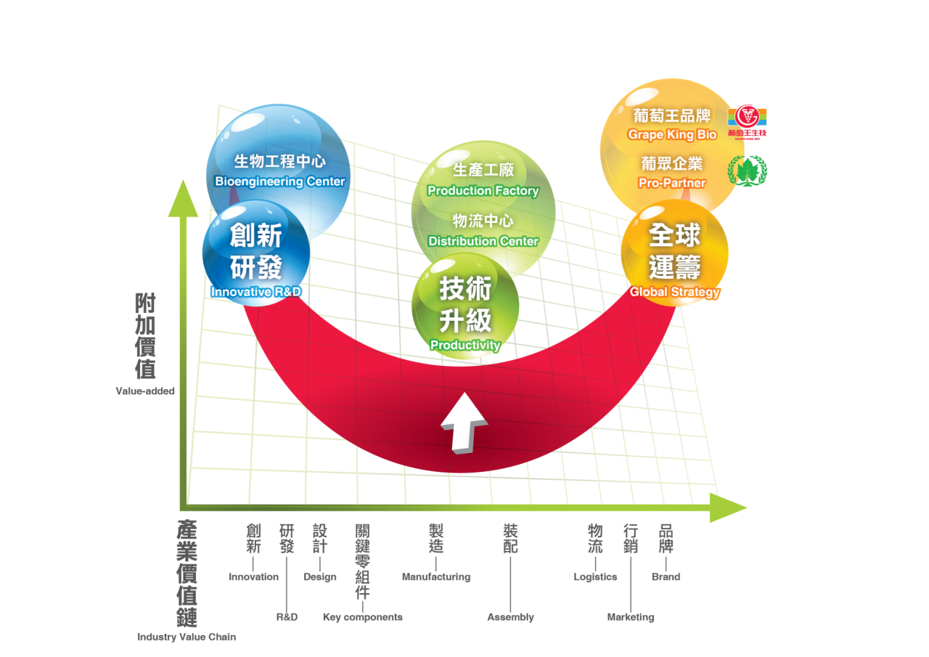
Grape King’s Smile Curve

Slide 24
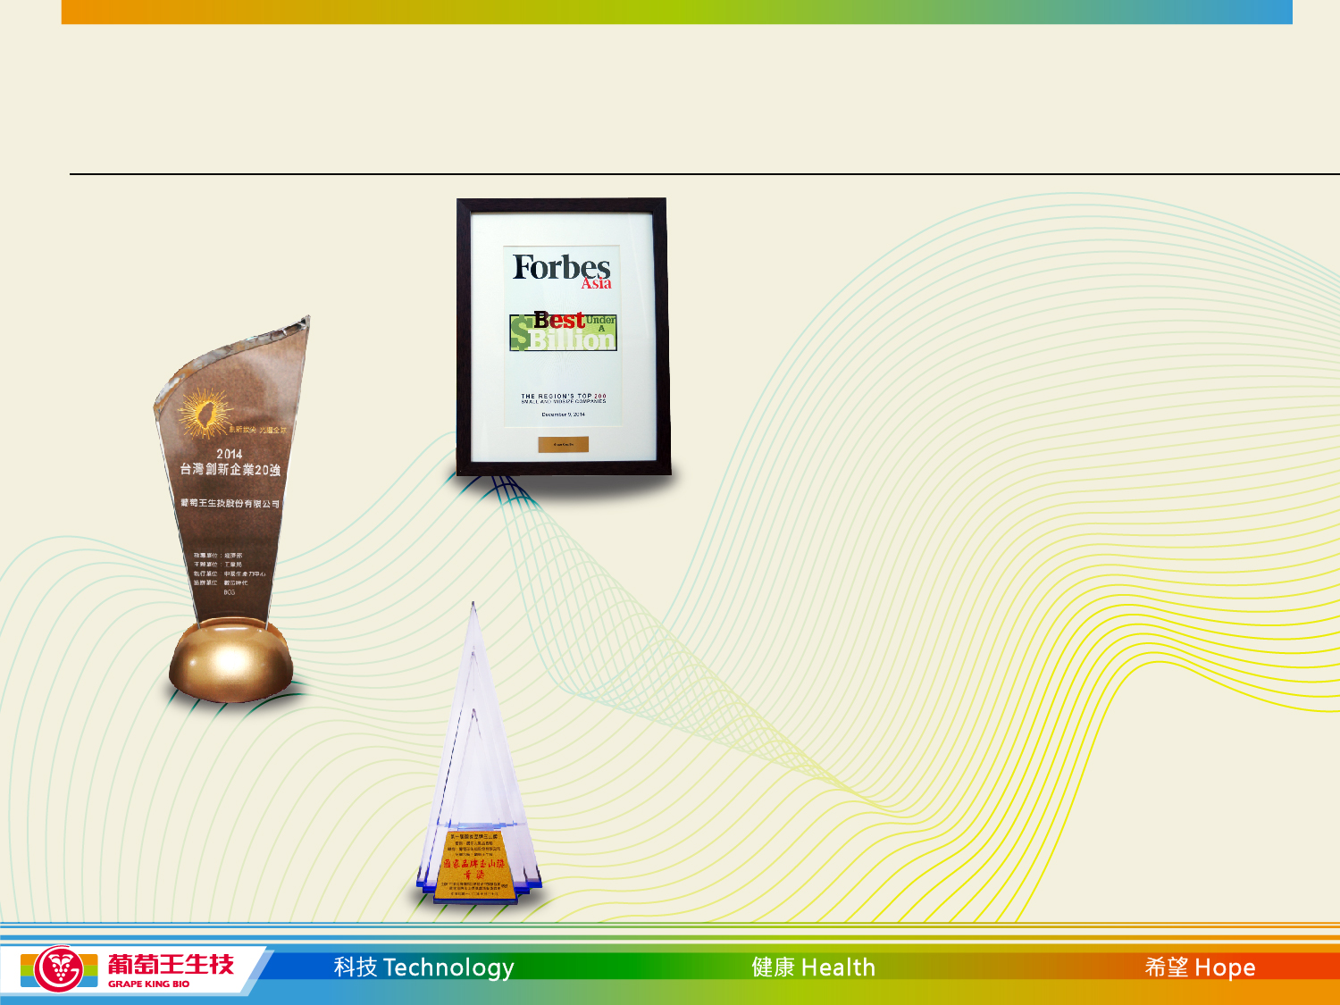
Grape King Bio Achievements
Grape King Bio was listed in Forbes
“Asia’s 200 Best Under a Billion”
for 2014 and 2015
In 2014, Grape King Bio was awarded by the
TOP 20 Innovative Companies of Taiwan
In 2013, Grape King Bio was awarded with
National Brand Yushan Award- The Most
Popular Brand Award

Slide 25
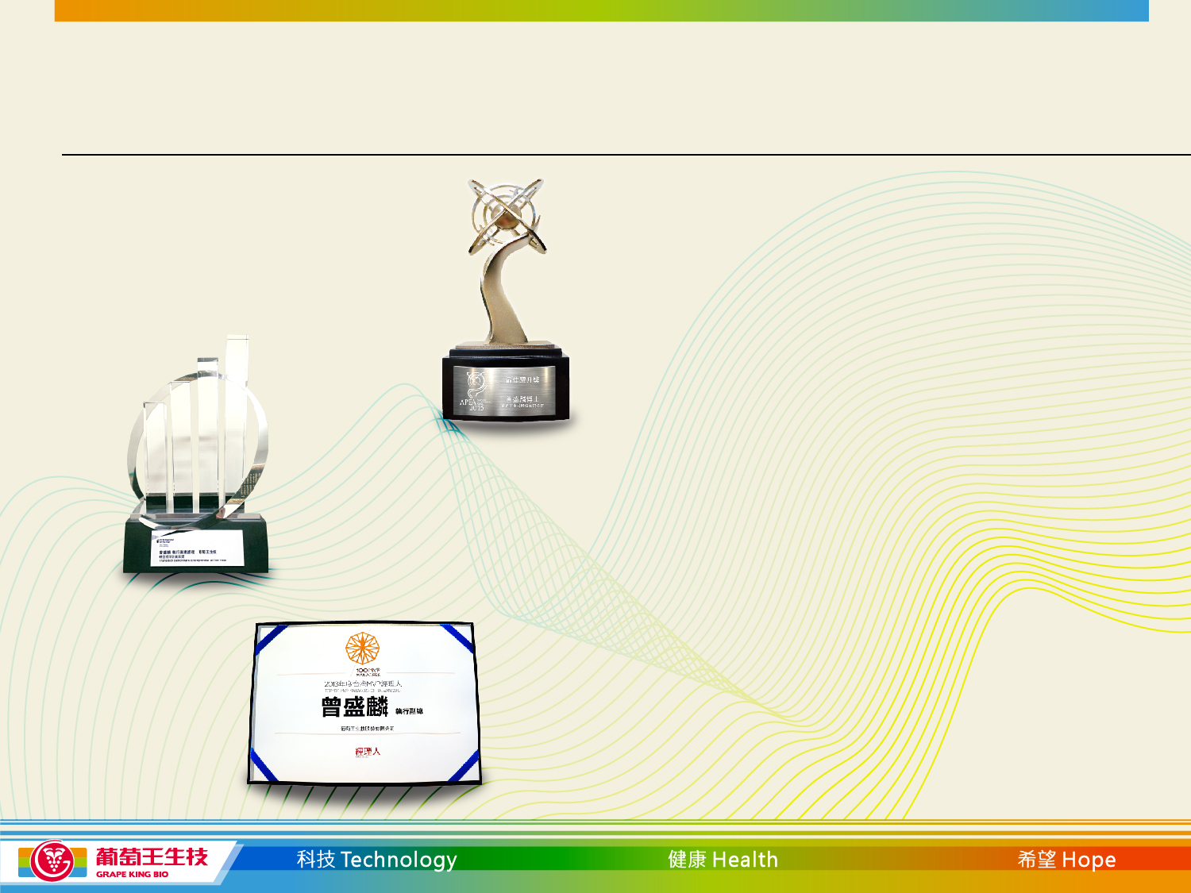
Grape King Bio Achievements
Dr. Andrew Tseng was awarded
with the “Most Promising Category”
award by The Asia Pacific
Entrepreneurship Awards 2015
In 2013, Dr. Andrew Tseng was awarded with
the Ernst & Young Entrepreneur of the Year
"In Transition Benchmarking Entrepreneur Award"
In 2013, Dr. Andrew Tseng was awarded
with the Manager 100MVP Annual Award

Slide 26

Thank you

